Slide 1
INSTRUCTIONS
How to use this template
SLIDE TO BE REMOVED ONCE COMPLETED
The purpose of this template is to provide a guidance of the key elements that need to be covered by the different teams who participate in the Microsoft Agentic Industry Hackathon 2026 initiative.
The whole initiative starts with an idea: How we can use AI Agents to improve the business.
Once the idea is clear, use this template to define and design the Use Case around it so it can be evaluated by the Microsoft Agentic Industry Hackathon 2026 judging team who will decide which ones are the best ones to move to the implementation phase. To evaluate each idea, it must come with the elements described in this deck, so apples can be compared with apples.
There are 4 key elements to be described:
Use Case description from functional and business perspective:
Business Process of which the Use Case is part of and what part of the process is covered by the Use Case
Business Case to implement it.
High Level Solution from Functional and Technical perspective
The following slides will allow you to provide the necessary content. All the content included is provided as an example. Please update the template master to include the name of the process and update the content accordingly.
Good luck!

Slide 2
USE CASE AND ARCHITECTURE TIPS
SLIDE TO BE REMOVED ONCE COMPLETED
There will continuous office hours and support from Capgemini industry experts and Microsoft Partner Solution Architects
Use Case
Architecture
To ensure every hackathon project delivers meaningful impact, teams must have a use case across several key dimensions that drive business value and responsible innovation.
This framework helps assess whether a proposed AI solution is not only creative but also feasible, scalable, and aligned with real user needs.
This validation highlights whether the proposed design uses the right.
capabilities of Azure, Microsoft Fabric, Microsoft Foundry, GitHub Copilot, M365 Copilot Studio, and Dynamics Copilot and aligned with the Well‑Architected Framework
The architecture will directly feed into provisioning the team’s hackathon environment, ensuring all required components are correctly configured from the start.
Problem Significance – Is this an important problem?
User Impact – Who benefits and how much?
Innovation – What’s new or creative here?
AI Fit – Is AI the right tool for the job?
User Experience – Is it simple and intuitive?
Responsible Design – Are safety and ethics addressed?
Feasibility – Can it realistically be built now?
Scalability & Security – Can it scale securely?
Reusability (MCP) – What parts can be reused elsewhere?
KPI Impact – What measurable value will it deliver?
Clear Architecture Flow – Is the end‑to‑end design simple and clear?
Platform Fit – Are the platforms used appropriately?
Data & Governance – Is data storage and access well‑defined?
Security – Are identity, access, and protection measures in place?
Reliability – Does the design handle failures and recovery?
Performance – Is the solution optimized for speed and efficiency?
Cost Awareness – Are compute and AI resource costs considered?
Scalability – Can the solution grow without redesign?
Integration – Are connections between components defined?
Provisioning Readiness – Does the design list all

Slide 3
Half Finals check Criteria
SLIDE TO BE REMOVED ONCE COMPLETED
HALF FINALS
ideation and architecture selection
When accepted to the HALF FINALS teams will get the environment envisioned in their design and will be asked to make their implementation for the finals selection.
Use Case and Architecture validation
Teams will be evaluated on the use case and on the proposed architecture, impact and completeness
Architecture (0-10 each):
Clarity & Flow – Does the architecture present a clean, easy‑to‑understand end‑to‑end flow that clearly shows how components interact?
Platform Fit – Are the chosen Microsoft platforms and services appropriate for the problem and used in the right way?
Data/Gov/Sec – Is data stored, accessed, and governed securely with proper controls, policies, and identity measures in place?
Reliability/Perf/Cost – Is the solution built to run reliably, perform efficiently, and avoid unnecessary consumption or cost?
Scalability/Integration/Provisioning – Can the solution scale smoothly, integrate with required systems, and be provisioned in a consistent, repeatable way?
Use Case (0-10 each):
Value & KPI Impact – Does the use case deliver tangible business or user value with clear KPIs that can be improved or measured?
Innovation – Does the solution introduce a novel, differentiated, or uniquely beneficial approach compared to current ways of working?
AI Fit – Is AI genuinely adding value and used appropriately and responsibly within the solution?
UX Simplicity – Is the user experience intuitive, natural, and easy enough that users can quickly understand and benefit from it?
Build‑Scale‑Reuse – Is the implementation feasible to build now, scalable in real environments, and able to reuse or contribute reusable assets (e.g., MCP components)?

Slide 4
WHY
Business Challenges
Use Case Description
KPIs Impacted
Developers rely on public LLMs (e.g., OpenAI) that pose data privacy and compliance risks.
Knowledge loss across internal repositories (code, docs, and runbooks).
Manual searches and onboarding slow developer productivity and incident resolution.
Existing assistants lack organization-specific terminology and guidance.
Build a private, domain-specialized coding assistant by fine-tuning a Mistral-based LLM on enterprise datasets, including source code, documentation, SOPs, and runbooks, using Azure AI Foundry.
The model is deployed within a secure Azure environment and integrated with development workflows (e.g., GitHub) to provide context-aware code generation, automated debugging, and intelligent troubleshooting support.
Leveraging VNet isolation, RBAC, and secure data pipelines, the solution ensures end-to-end data privacy while aligning responses with the organization’s coding practices and system architecture.
↑ Developer productivity (measured by reduced search and debugging time).
↑ Model accuracy on internal queries (>90% validated helpfulness rate).
↓ Support turnaround time for incidents.
↓ Unapproved model usage and external API costs.
Private AI Code Assistant — End-to-End Fine-Tuning Workflow
Business Impact
Enables compliant AI-assisted coding within organizational boundaries.
Retains and leverages institutional knowledge securely.
Reduces dependency on external AI vendors.
Accelerates development cycles and incident resolution through AI-driven context reuse.
HOW
WHO
Functional Solution
Technical Solution
Stakeholders
Aggregates internal knowledge: source code, docstrings, runbooks, and PR reviews.
Generates JSONL training pairs (prompt–completion format).
Fine-tunes a Mistral LLM (Large or Nemo) via LoRA SFT for internal language, tone, and structure.
Deploys a Foundry-hosted REST API endpoint (OpenAI-compatible) serving internal developer tools.
Integrates with VS Code GitHub Copilot for seamless access.
Azure Architecture:
Azure AI Foundry → model catalog, LoRA fine-tuning, monitoring.
Azure Blob Storage → data staging area (optional).
Azure Key Vault → API secrets and credentials.
Azure Monitor → telemetry, drift, and performance tracking (optional).
Fine-tuning Method: LoRA / QLoRA adapters for cost-efficient supervised fine-tuning on code-doc data.
Security: Private endpoint, VNet isolation, Entra ID authentication, RBAC-enforced.
Product Owner: AI/Automation Lead
Technical Stakeholders: ML Engineers, DevOps, Azure Architects
End Users: Software Developers, SREs, Support Engineers
Compliance: Security & Data Governance Teams

Slide 5
Use Case Scope in the Business Process
Detail the business process and highlight the Use Case in the process
Use Case scope
L1
Campaign Management
L2 4 sub-processes
Campaign Planning
Campaign Design
Campaign Execution & Follow Up
Campaign Supervision
PROCESSES
L3 13 macro tasks
Performance Analysis & Territory wise Brand Analysis
Select Territories
Create Collaterals
Content Generation
Content Assembly
Quality & Compliance
Distribute Campaign
Engage Sales Teams
Conversion Tracking
Campaign Adjustments
Content Request
Bottleneck resolution
Approval
L4 36 micro tasks
AGENT
AGENT
AGENT
GENAI
AGENT
AGENT
AGENT
AGENT
AGENT
Content Manager
Territory Selector
Population
Selector
Brands & Territories List Summary
Real-Time Content Adapter
Compliance Checker
Sales Call Manager
ROI Optimizer
Approval Manager
DATA & AI
RAG
Data platform, data governance, data management
Transforming the apps landscape, integrating with apps, infrastructures & data landscapes:
DIGITAL
Third Party
Sales Info
Handheld & Interactive Systems
Brand Master
CRM
Campaign Master
SFA System
Other Tools
Human
RPA/script
AI/ML
Gen AI
Agentic AI
Outcomes
(if at scale)
+ 40-80%
+ 20-35%
>90+%
+ 50-70%
Faster Campaign Cycle Time
More time on Strategy
Automated QA & Compliance Checks
Productivity (FTE Hours Saved)

Slide 6




Functional Solution + AI-Human Chemistry
Provide a Diagram with the functional components of the solution and the points where the Agent(s) will take decisions or will handle it to humans
Request missing/ conflicting information
Service Agreement
Interaction (customer, third- party or internal teams)
Gather approval if needed
Agent1
Text to Insight
Agent interacting only with systems not with humans
Inbound Channels
Contract Created
Job Failure in JCL
Mainfram job moni
Validate Information
Create contract
Update pricing & Block
Sales raises request to modify agreement
ServiceNow
Language Translation
Communicate to customer/Sales & AR team
Update Contract
Rebates Payout
Agent2
Create/upload Settlement
Inbound Channels
Credit Note created
Sales request for Settlement of Agreement
ServiceNow
Gather CN approval
(get approval in case out of def. threshold)
Create Credit Note
Capgemini request to validated Payout date
Communicate to customer/Sales and AR team

Slide 7
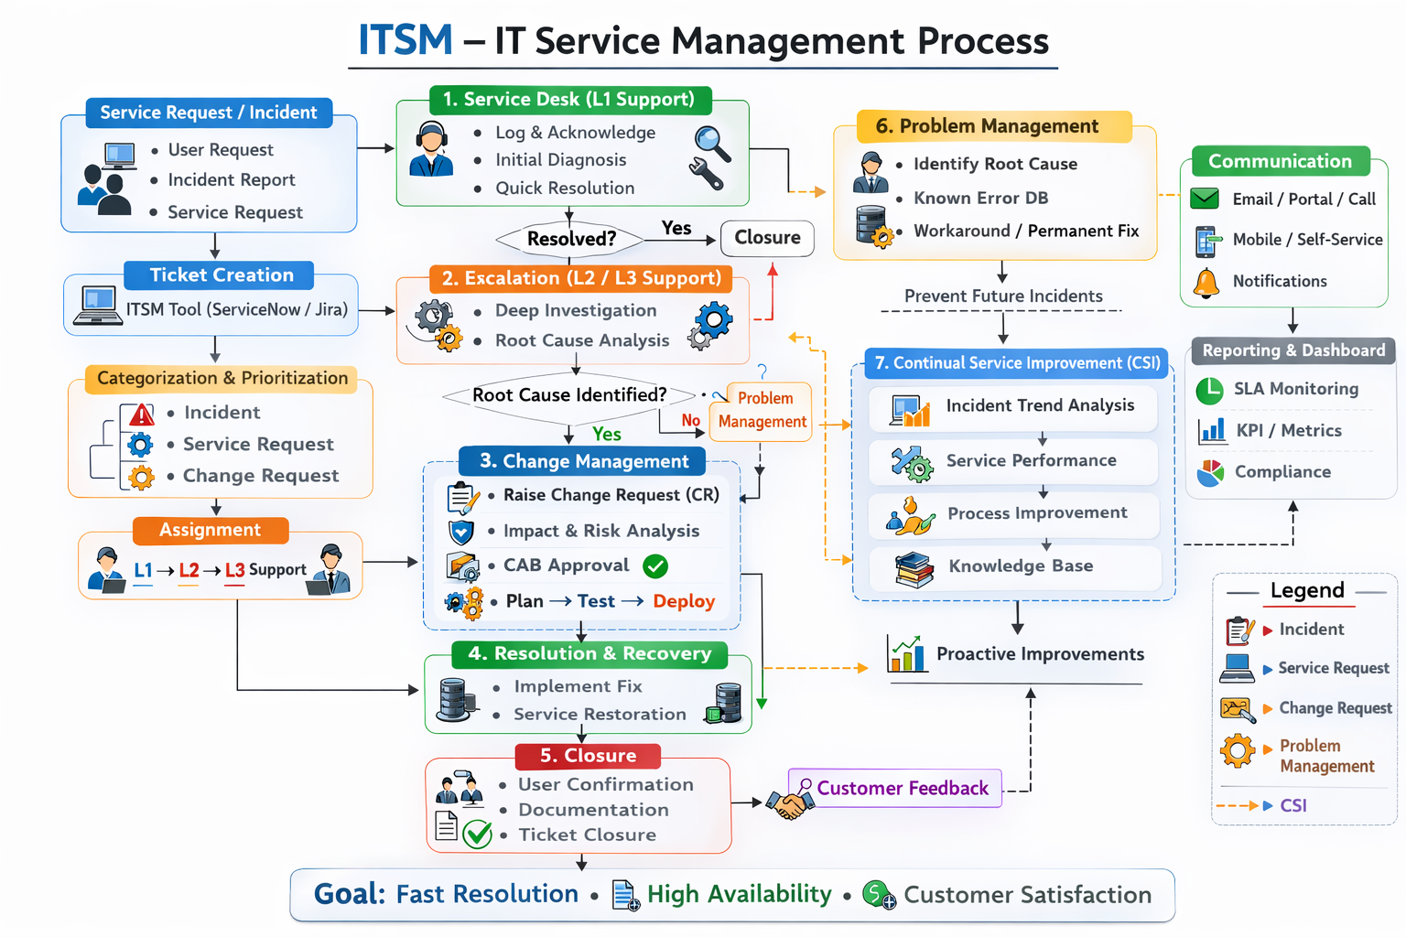
Technical Solution
Provide a Diagram with the Technical components of the solution and the key Microsoft components that will be used
technologies
GitHub Copilot
Microsoft Foundry
Microsoft Fabric
M365 Copilot
Copilot Studio
D365 Copilot

Slide 8
Business Case Proposal – Medical AI Assistant
WHY
BUSINESS CASE
KPIs Impacted
Current Costs
Current Income
⬆️ 25–35% Reduction in clinician administrative workload ⬆️ 20–30% Faster patient response time ⬆️ 15–25% Improvement in patient satisfaction scores ⬆️ 10–20% Increase in operational efficiency
Manual documentation workload: High operational cost Administrative staff dependency: ₹15–20 Lakhs/year Delayed patient handling → indirect revenue loss
Revenue (Rv1): Revenue impacted due to delays and inefficiencies Estimated Annual Revenue: ₹1–2 Crores
New Costs
New Income
Business Impact
Model Development (Mistral Fine-tuning): ₹8–10 Lakhs Azure Deployment & Infrastructure: ₹5–7 Lakhs/year Maintenance & Updates: ₹3–5 Lakhs/year
Revenue (Rv2): Increased patient handling capacity Faster turnaround → more consultations Improved service quality → higher retention
Expected Revenue Increase: +10–20% (₹20–40 Lakhs/year)
Reduces clinician burnout by automating documentation and routine queries
Improves patient experience through faster triage and appointment handling
Enables doctors to focus more on critical care instead of paperwork
Enhances decision-making with AI-powered clinical support
Ensures standardized and accurate medical documentation
Total New Cost (Year 1): ~₹15–20 Lakhs
BREAK EVEN:
Time to recover implementation cost: 12–18 months through: Reduced admin staffing costs Faster workflows
BREAK EVEN: Time to recover via extra revenue: 8–12 months due to: Increased patient throughput Better service quality
BREAK EVEN: The solution becomes financially viable within the first year due to: Immediate reduction in administrative burden Increased efficiency and patient handling capacity Scalable AI model with long-term cost benefits This makes the solution highly feasible and ROI-positive for healthcare organizations.

